Slide 1
Mathematics for AI

Slide 2
Course Schedule
week.1
week.2 ~ 3
week.4 ~ 5
week. 6 ~ 7
week.8 - 9
week.10 ~ 11
week.12 ~ 13
Week.14 ~ 15
Course introduction
Vector
When Models Meet Data
Linear Regression
Dimensionality Reduction with PCA
Density Estimation with GMM
Classification with SVM
Mid-term examination
“Mathematics for Machine Learning“ Marc Peter Deisenroth
Linear Algebra
Analytic Geometry
Matrix Decomposition
Vector Calculus
Probability and Distribution
Continuous Optimization
Project Presentation
Final examination
Class: Mon. 9am ~ 12pm
Office Hour: Mon afternoon @231, W19, or over kakaotalk (010-6799-6636)

Slide 3
Data, Models, and Learning
There are three major components of a machine learning system: data, models, and learning.
The main question of machine learning is “What do we mean by good models?”.
We briefly outline the current best practices for training a model such that the resulting predictor does well on data that we have not yet seen.

Slide 4
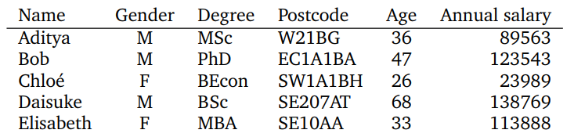
Data as Vectors
Data in tabular form, represented by N D-dimensional vectors
Each row to be a particular example (n = 1, …, N)
Each column to be a particular feature (d = 1, …, D)
D
N
X = {x₁, …, x_{n}} ∈ R^{NXD}
Y = {y₁,…, y_{n}} ∈ R

Slide 5

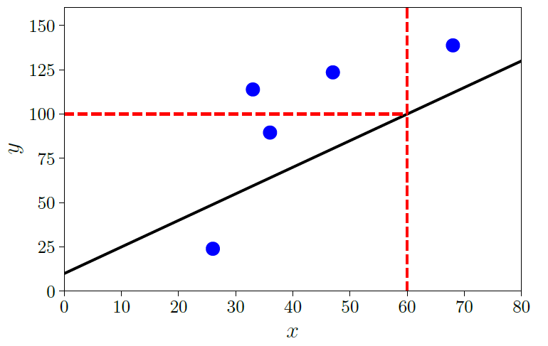

Models as Functions
A predictor is a function with input of x, output of y
x is a D-dimensional vector, y is a real number
In this book, we consider the linear functions, (or affine function, when , θ and x are tensors)

Slide 6
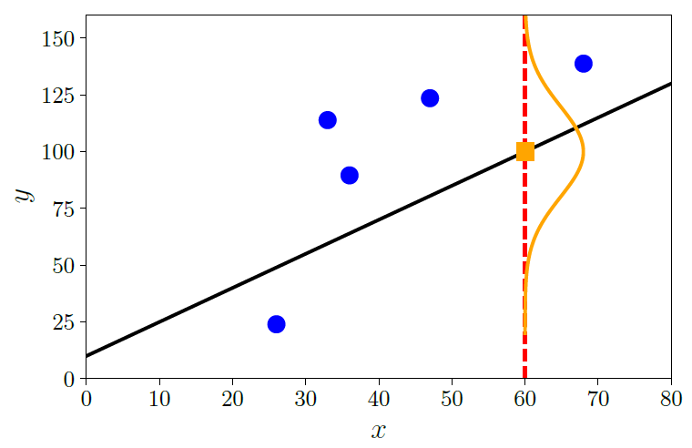

Models as Probability Distributions
A predictor is a probability distribution with given parameter of θ
E.g. Gaussian, Bernoulli, Poisson distribution

Slide 7
Learning as Finding Parameters
There are conceptually three distinct algorithmic phases
Hyperparameter tuning or model selection
number of parameters, or specific distribution
Training or parameter estimation
For the non-probabilistic model, we follow the principle of empirical risk minimization
With a statistical model, the principle of maximum likelihood is used maximum likelihood to find a good set of parameters
⬅ hill climbing approaches where ‘the gradients (vector calculus)’ is to be used
Prediction or inference

Slide 8
Empirical Risk Minimization
There are four main design choices
What is the set of functions we allow the predictor to take? (e.g. affine function)
How do we measure how well the predictor performs on the training data?
(e.g. least square function)
How do we construct predictors from only training data that performs well on unseen test data? (model selection to avoid overfitting)
What is the procedure for searching over the space of models?

Slide 9
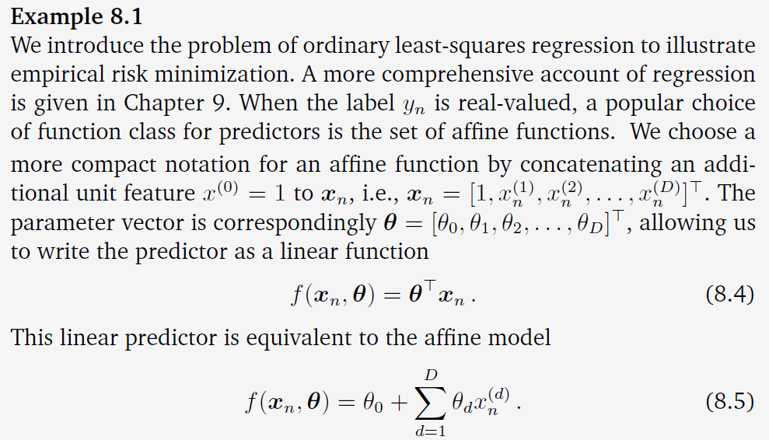
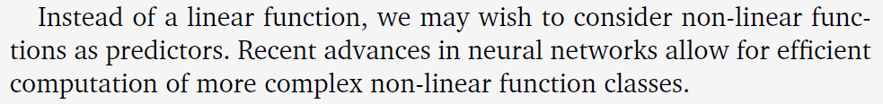
1. What is the set of functions we allow the predictor to take?

Slide 10
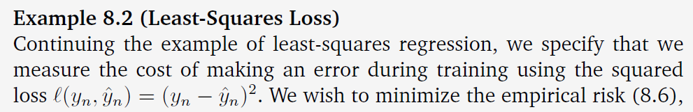
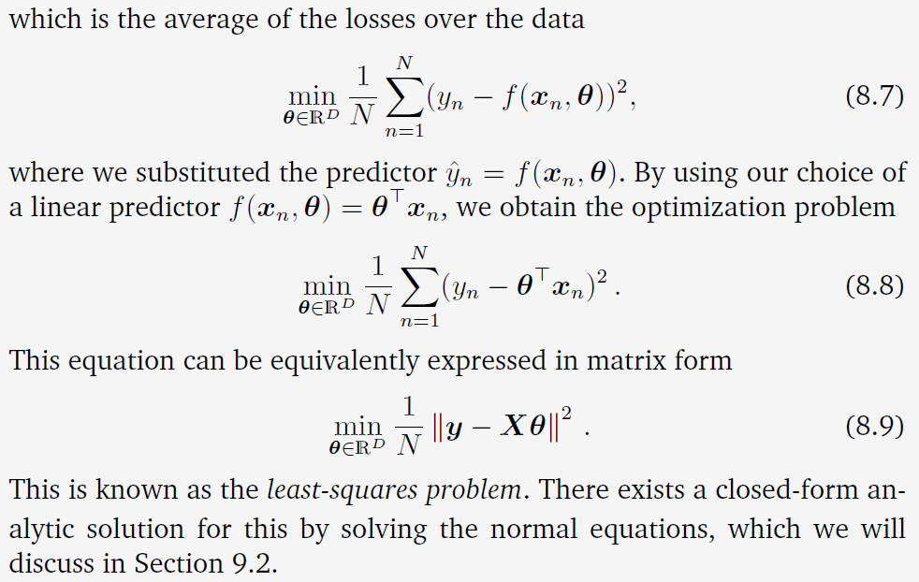
2. How do we measure how well the predictor performs on the training data?

Slide 11
2. How do we measure how well the predictor performs on the training data?

Slide 12
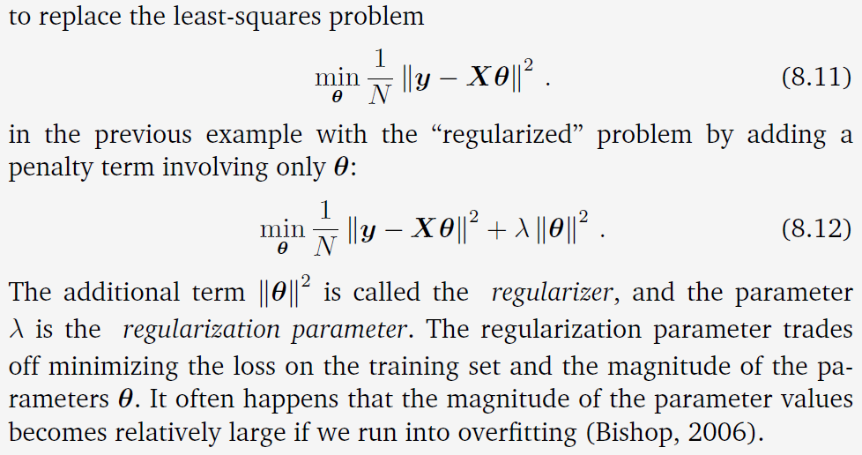
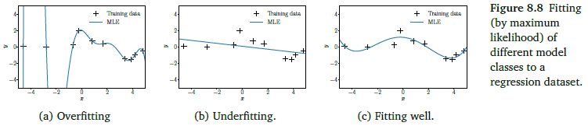
3. How do we construct predictors from only training data that performs well on unseen test data?
Regularization to Reduce Overfitting
Replace the least-square error with the regularized one with penalty term

Slide 13
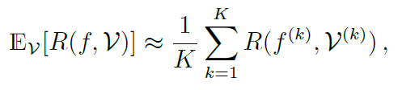
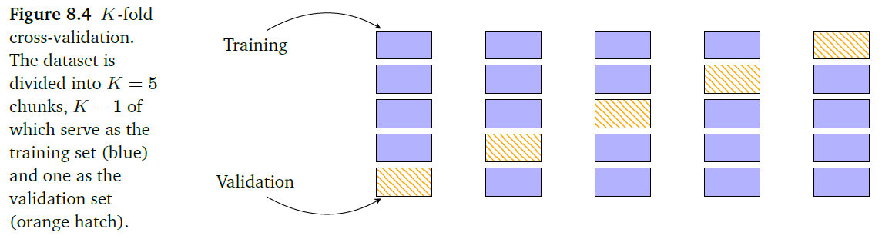
3. How do we construct predictors from only training data that performs well on unseen test data?
Cross-Validation to Assess the Generalization Performance
Expected generalized error

Slide 14
Learning as Finding Parameters
There are conceptually three distinct algorithmic phases
Hyperparameter tuning or model selection
number of parameters, or specific distribution
Training or parameter estimation
For the non-probabilistic model, we follow the principle of empirical risk empirical risk minimization
With a statistical model, the principle of maximum likelihood is used maximum likelihood to find a good set of parameters
⬅ hill climbing approaches where ‘the gradients (vector calculus)’ is to be used
Prediction or inference

Slide 15
Models as Probability Distributions
A predictor is a probability distribution with given parameter of θ
E.g. Gaussian, Bernoulli, Poisson distribution

Slide 16

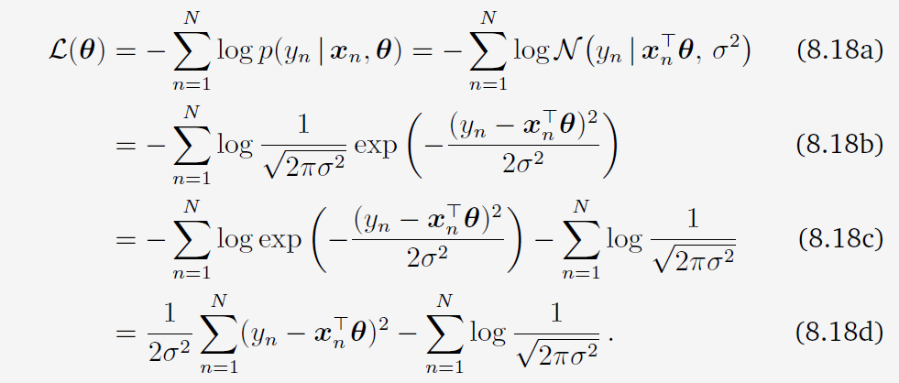
Parameter Estimation – Statistical Model
Maximum Likelihood Estimation (MLE)
the negative log-likelihood function
Gaussian likelihood

Slide 17

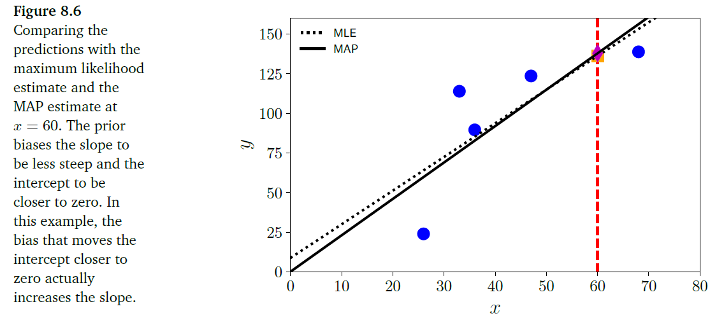
Parameter Estimation – Probablistic Model
Maximum A Posterior Estimation (MAP)
updating the probability based on prior knowledge

Slide 18
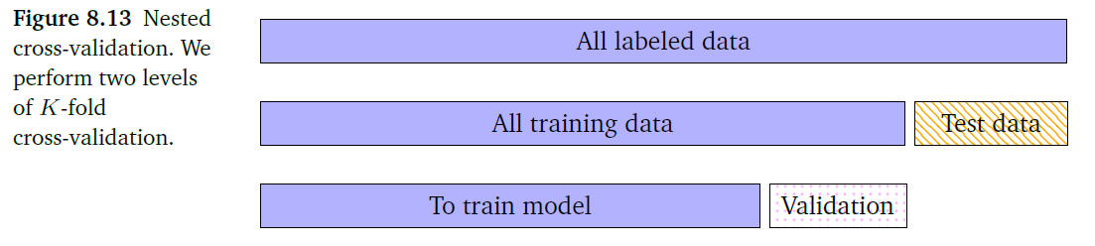
How to avoid overfitting?
Nested Cross-Validation

Slide 19
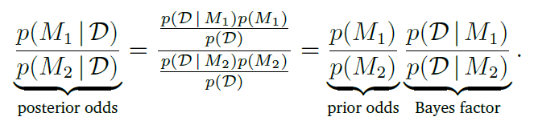
How to avoid overfitting?
Bayesian Model Selection

Slide 20
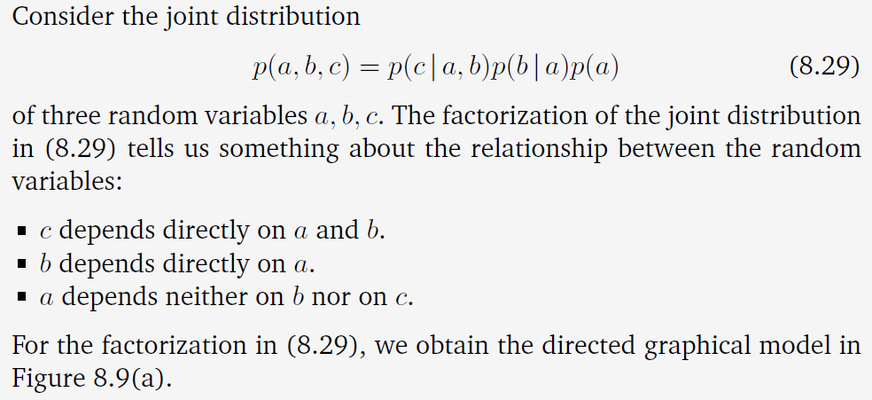
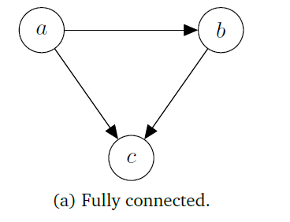
Directed Graphical Models
Represent causal relation by directed graph

Slide 21

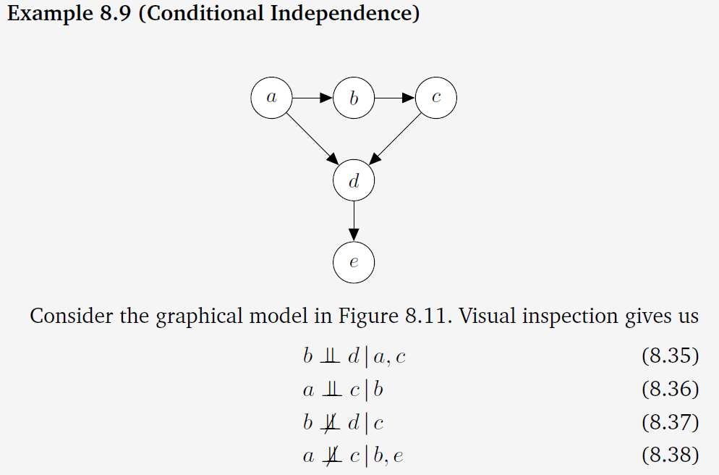
Directed Graphical Models
Conditional Independence
“A is conditionally independent of B given C”, denoted by

Slide 22
Directed Graphical Models
Conditional Independence
“A is conditionally independent of B given C”, denoted by

Slide 23
Exercise
Choose one of below topics and Explain
Normal equation to solve least square problem
Bayes Theorem and Conditional Probability

Slide 24
Homework
Read Chapter 2. Linear Algebra

Slide 25
Next Week
Linear Algebra
Solving Systems of Linear Equations
Vector Spaces, Affine Spaces
Linear Independences and Basis
Linear Mapping

Slide 26
BongGyun Kim
Office hour: Mon. 2pm ~ 6pm
@ room 231, building W19
Phone: 042-629-6636
Mobile: 010-6799-6636
bonggyun.kim@endicott.ac.kr

Slide 27
End of Week 2

